Slide 1
AWS
Part 2

Slide 2
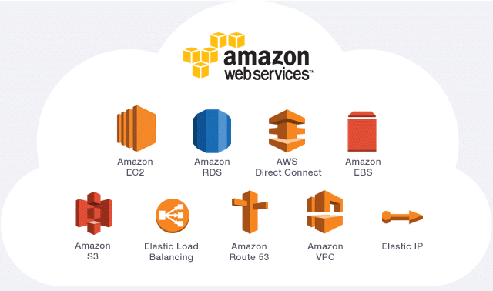

Slide 3
This is the second part of the lesson on AWS. Make sure you go through the first lesson before taking this lesson
Note: Make sure you can access your account created on aws platform (aws.amazon.com)

Slide 4
Table of content
Introduction
Exploring the AWS console
The VPC
Creating servers in a VPC
Access management in AWS

Slide 5
Introduction
1
Starting with AWS

Slide 6
Introduction
Nowadays almost all companies have websites and applications running online to serve clients
Before the cloud, companies used to create their own physical data centers in buildings where all the servers needed were built and kept
All these companies apps and websites function almost the same.
Let’s look at the process behind the apps and websites online

Slide 7
All companies app or websites follow this simple Principle
Database server
Load Balancer
Web server 1
Internet
Database server
Web server 2

Slide 8
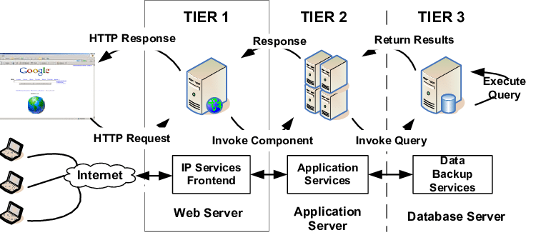
All companies app or websites follow this simple Principle

Slide 9
Introduction
Today, cloud services providers like aws enables you to create a virtual datacenter (datacenter in the cloud)
Example:
To create a database you can use the RDS service in aws.
To create a load balancer, you use the Elastic Load balancer service.
To create a server, you use the EC2 service

Slide 10
Introduction
Services in aws are Elastic:
This means your ressources can be scaled up or down anytime, based on your needs
Example: You can scale your servers capacities up or down depending on what performances you need them to have
You can switch the Hard disk capacity of a server from 40GB to 80GB within seconds, depending on your need
You pay just for what you use: Pay As You Go

Slide 11
Security in the cloud
The Virtual Private Cloud

Slide 12
Introduction
Before the cloud, companies needed
To assure the physical security and maintenance of their servers in the datacenter
To assure the security of their clients or customer data
To create their physical network (connecting cables, routers and all other network equipments)
Today, AWS provides a service called VPC to manage that!

Slide 13
Introduction
The VPC (Virtual Private Cloud) is the aws service that allows you to create your own private space or network in the cloud
After setting your VPC, you can launch your various instances inside of that secured network
Thus, this service can enable you to create a DMZ in the Cloud
DMZ stands for DeMilitarized Zone
In network security, a DMZ is like a subnet that sits between the public internet and the private network

Slide 14
Introduction
The DMZ protects the organization’s internal Local Area Network from untrusted traffic
DMZ
Database server
Load Balancer
Web server 1
Internet
Database server
Web server 2

Slide 15
Perimeter (DMZ) VPC
The Perimeter, or DMZ, VPC contains the necessary resources for AMS Operations engineers to access AMS networks.
It contains public subnets across 2-3 AZs, with SSH Bastions hosts in an Auto Scaling group (ASG) for AMS Operations engineers to log into or tunnel through.
The security groups attached to the DMZ bastions contain port 22 inbound rules from Amazon Corp Networks.

Slide 16
Exploring the AWS console
2
AWS console

Slide 17

AWS console
Sign in to your aws account using your credentials
You can save the credentials for the page to remember you when signing in the next time
To check the various services provided by aws, click on Services
The services are grouped by category but you can display in alphabetical order using the (A-Z) button at the right:

Slide 18

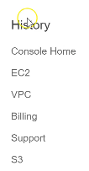
AWS console
The History will display all the services that you used lately
You can also pin some services you will mostly use
To do that:
Click on the pin symbol
Drag a specific service
Drop it in the panel beside the pin
Pin the IAM service

Slide 19
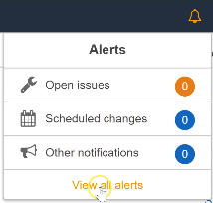
AWS console
Clicking on the bell symbol, will display all the notifications
You can click on View all alerts to check the alerts that the system sends to your account
Alerts can concern:
Problems with availability zones
Problem with your data center
Announcements
Your servers issues etc.

Slide 20
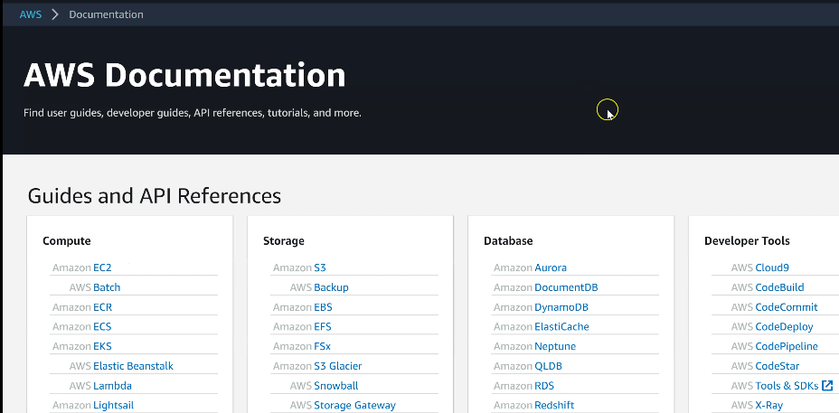
AWS console
In the Support button, you can find the aws Documentation on all aws services and how to use them

Slide 21
The VPC
3
Virtual Private Cloud

Slide 22
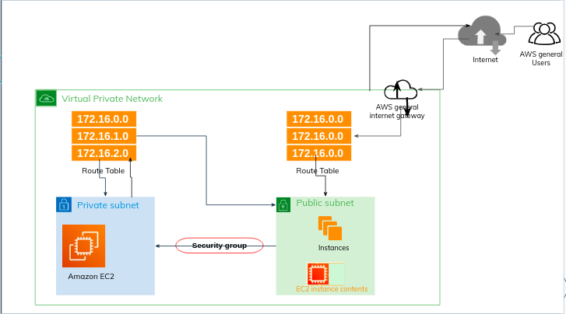

Slide 23
The VPC
When you create a server (EC2 instance) on aws, it must belong to a VPC
If you don’t provide one at the server’s creation, aws will provide a default VPC for your instance
Let’s take a look at the instance we created in the first lesson:
Open the EC2 service
Click on Services
Click on EC2 in the Compute category

Slide 24

The VPC
Click on Instances in the left panel to check all the instances running
Click on the instance firstinstance we created previously and check the description below
In the Description, you can see VPC ID, subnet ID …
These are the default VPC and the default subnet that were provided when you launched the instance

Slide 25
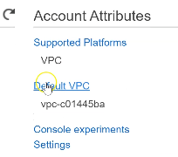
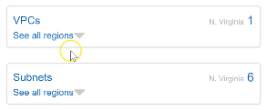
The VPC
In the left panel, click on the EC2 Dashboard
Click on Default VPC in Account attributes in the right panel
You can see VPC 1 and subnets 6
We have 6 subnets because in the Region N Virginia, there are 6 Availability Zones (AZ)
So, by default, a subnet will be created in each availability zone

Slide 26
Availability Zone
An Availability Zone (AZ) is an isolated location in a Region
It is like a physical data center location in a specific Region
The AZs are independent: ie if one is down, that does not affect the other.
In N. Virginia Region, we have 6 availability zones ie. if one zone is down, the other one takes the hand

Slide 27

The VPC
Those parameters were the ones created by default. Let’s create our own VPC and subnets
To creating a VPC, open the VPC service
Click on Services then go to the Network and content Delivery
Click on VPC
In the VPC Dashboard
Click on Launch VPC Wizard

Slide 28
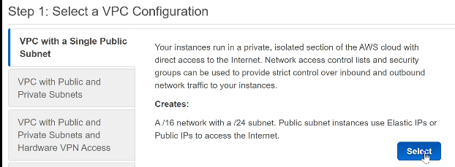
The VPC
Step 1: Select a VPC configuration
Allow VPC with Single Public Subnet
Click on Select

Slide 29
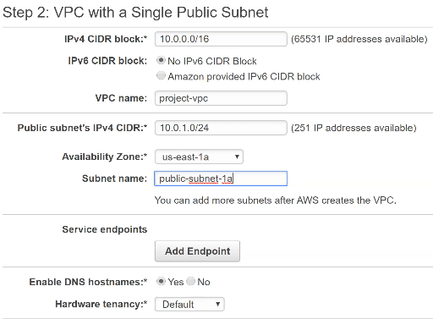
The VPC
Step 2: VPC with Single Public Subnet
IPV4 CIDR block : 10.0.0.0/16
VPC name: project-vpc
Public subnet : 10.0.1.0/16
Availability zone: us-east-1a
Subnet name: public-subnet-1a
Click on Create VPC

Slide 30
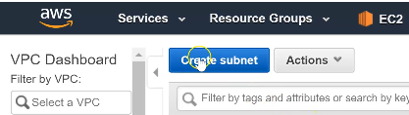
The VPC
You can see the VPC successfully created: click on OK
You can see 2 VPCs: the default and the project-vpc we created
Since the VPC was created with a public subnet (public-subnet-1a), let’s create a private subnet:
Click on Subnets in the left panel
Click on Create a subnet

Slide 31
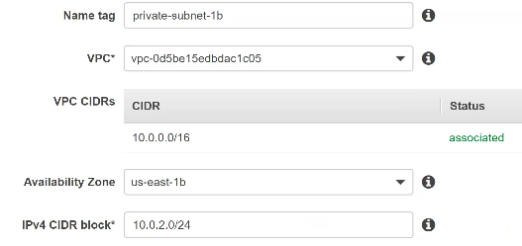
The VPC
Name tag: private-subnet-1b
VPC: choose the project-vpc
VPC CDIRs will be associated
Availability zone: us-east-1b
IPV4 CIDR block: 10.0.2.0/24
Click on Create

Slide 32
The VPC
You will get the message: The following subnet was created:
Click on Close
Now, we have a private an a public subnet in our project-vpc
Note:
Every server created in a public subnet will have a public address
Every server created in the private subnet will have a private IP address that is not accessible through the Internet

Slide 33

The VPC
Now, we need a Gateway to enable the VPC to communicate through the internet
In the left panel, click on Internet Gateways
You can see a default gateway was provided for our project-vpc
Let’s modify its name:
Name: IGW-projet

Slide 34
The VPC
Now, let’s create the Route Tables
In the left panel, click on Route Tables
We can see 2 route tables attached to our project-vpc:
A main table (Main=yes) and another Route Table

Slide 35
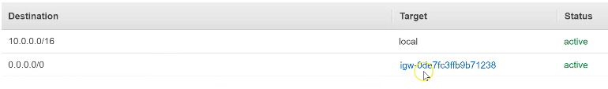
The VPC
If you select the main table and click on the Routes tab in the description below, you will see that it accepts only local traffic
If you select the other table and click on the Routes tab in the description below, you will see that:
It accepts local traffic
And also traffic from the internet (public 0.0.0.0/0) through our gateway

Slide 36

The VPC
Thus, we can choose the main Route as our Private-route and the other one as the Public-route:
Modify the names accordingly

Slide 37
Creating servers in a VPC
4
Virtual Private Cloud

Slide 38
Servers in a VPC
In a company, you cannot create a server without knowing to which VPC it must belong
Let’s launch an EC2 instance in our VPC
Open the EC2 service
In the EC2 Dashboard, click on Launch instance
Step1: Select the Amazon Linux 2 AMI (HVM) SSD volume type
Step 2: Allow the t2.micro Free tier Eligible

Slide 39
Servers in a VPC
Step 3: Configure Instance details
Number of instances: 1
Network: choose the project-vpc
Subnet: choose the private-subnet-1b
Scroll down to Advanced Details
User data: check thee As text radio Button
Enter the following commands in the text field provided

Slide 40
Servers in a VPC
Step 3: Configure Instance details
#!/bin/bash
yum update -y
yum install httpd -y
service httpd start
chkconfig httpd on
This User data is the place where you can specify user data to configure an instance or run a configuration script during the instance launch
This means, when the server is launching, let it run these commands in the bash shell

Slide 41
Servers in a VPC
Step 4: Add storage
Increase the storage capacity to 20 Gib
Step 5: Add Tag
Key = name and Value = secondserver
Step 6: Configure security group
In Assign a security group, choose Create a new security group radio button
Security group name: DB-SG (for Database Security Group)
Add rule: Type: MYSQL/Aurora

Slide 42
Servers in a VPC
Step 6: Configure security group
Click on Review and launch
Click on Launch
Click on Use an existing key pair then choose the awskeypair
Click on Launch instances
Now you can check the instances in the EC2 service
You can see that there is no Public IP address in the description

Slide 43
Access management in AWS
5
IAM Identity Access Management

Slide 44
Access Management
In the company, there are some people that need to access the resources or the instances you create in aws
AWS provides a service for Access Management: IAM
IAM stands for Identity Access Management
To open that service:
Click on Services
Go to the Security, Identity & Compliance group
Click on IAM

Slide 45
Access Management
This service enables you to create users accounts, groups, roles etc.
To create a user account, click on Users in the left panel:
Click on Add user
Step 1: Create User
Username: john
Select as Access type Aws Management Console Access

Slide 46
Access Management
There are two access types:
The Programmatic Access that enables access for development tools (especially for programmers or developers)
The Aws management console access that enables the user to sign in to the aws console using credentials.

Slide 47
Access Management
If you check the Require password reset, it will enable the user to create a new password at next sign in
Click on Next: Permissions
Step 2: Permissions
Click on Attach existing policies
Choose the AdministratorAccess for the test
Click on Next: Tags
Step 3: Add Tags(optional)
Click Next: Review

Slide 48
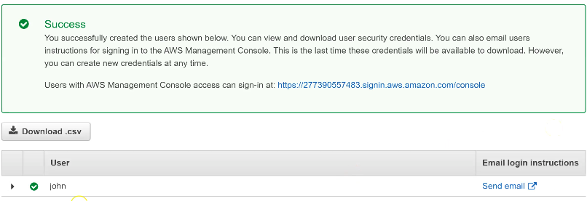
Access Management
Step 4: Review
Click on create user
Step 5: Success
You can click on Send email to send an email to user john

Slide 49
Creating a Group
How to create a group in IAM ?

Slide 50
Access Management
You may want to categorize users depending on what resources they can access in the structure
Example: You may want to create a group of users that can access an S3 bucket in the structure
Note: The S3 Bucket is a service in aws that provides an object storage system in the cloud.
S3 stands for Simple Service Storage
It is like a file system where you upload document files
It provides a URL to access each Object

Slide 51
Access Management
To create a group in IAM
Click on Groups in the left panel
Click on Create new group
Step 1: Set Group Name
Group Name: s3access
Click on Next step (scroll down if necessary)
Step2: Attach policy
Search for S3
Choose AmazonS3FullAccess
Click on Next step
Step 3: Review
Click on Create group

Slide 52
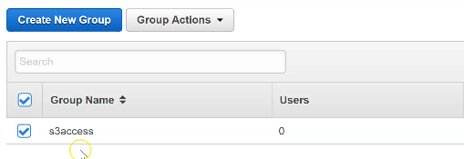
Access Management
The group is successfully created but there are 0 users in there
To add a user (john) to this group, you can
Click on Group Actions and select Add users to group

Slide 53
Access Management
The group is successfully created but there are 0 users in there
To add a user (john) to this group, you can
Click on Group Actions and select Add users to group

Slide 54
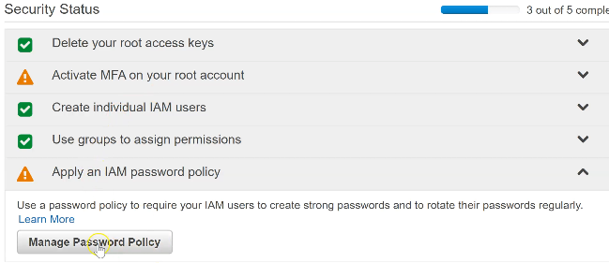
Access Management
To enable users to create secure or strong passwords, you need to set the password policy. To do that:
Click on Apply a password policy
Then click on Manage password policy in the IAM Dashboard

Slide 55
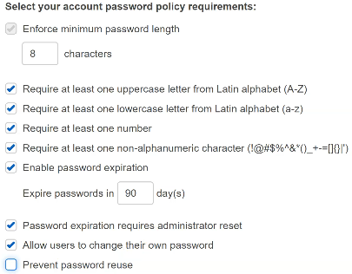
Access Management
Now, click on Set password policy and configure the password policy
Not checking the button Prevent password reuse allows users to reuse their old passwords
Click on Save changes
The security status for password policy is now turned to green in the Dashboard

Slide 56
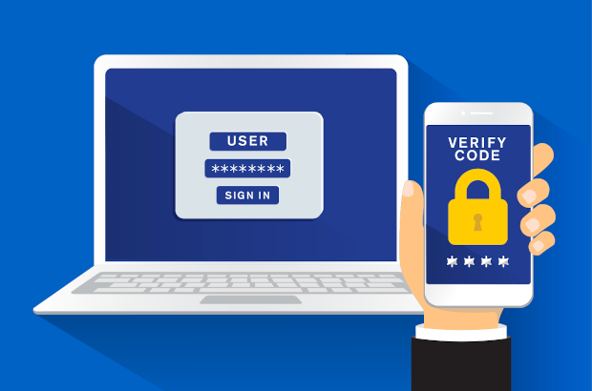
Access Management
The MFA (Multi-Factor Authentication) is a simple best practice that adds an extra layer of protection on top of your user name and password.
You need to download a MFA app on your phone to set that up

Slide 57
Roles in IAM
What is role?

Slide 58
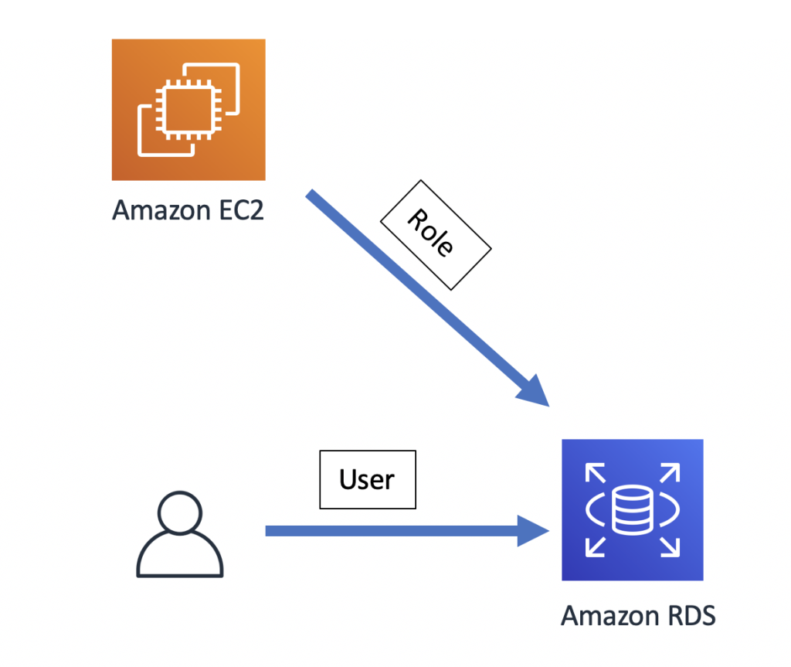
User VS Role in IAM

Slide 59
Access Management
Let’s say you have a S3 bucket in your structure
And the servers in the private subnet need to access the bucket to put in some data
That type of access that is from one resource to another is called Role
To create a role in IAM:
Click on Roles in the left panel
Click on Create a role

Slide 60
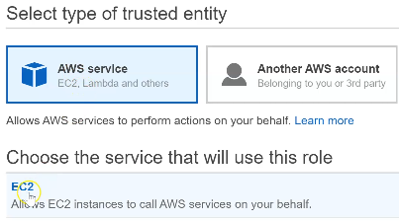
Access Management
Now, select the type of Trusted entity: AWS service
Choose the service that will use this role: EC2
Scroll down and click on Next: Permissions

Slide 61
Access Management
Attach permissions policies
Search for S3 and check AmazonS3FullAccess
Click on Next: Tags
Click on Next: Review
Give a name to the role: ec2S3access
Role description: Allow EC2 instances to call S3 services on your behalf
Click on Create role
You can see the new role created in the IAM Dashboard

Slide 62
Access Management
Attach the role to an EC2 instance
In the EC2 Dashboard, click on Instances
Choose an instance (Example: firstinstance)
Click on Actions, go to Settings
Click on Attach/Replace IAM Role
Choose the IAM role that we created (ec2s3access)
Click on Apply

Slide 63
Access Management
Attach the role to an EC2 instance
Now, every process in the instance firstinstance that needs to access the S3 bucket will run successfully
Any process from another instance (That does not have this role) trying to access the S3 bucket will fail
NB: while launching an instance, you can choose an IAM role at step 3

Slide 64
Security groups
How to create a security group?

Slide 65
Security groups
Creating a Security group
Open the EC2 dashboard
Click on Security groups in Resources
Click on Create a security group
NB: This is like opening a port on a server
Note: Always Terminate the Instances that you don’t need in aws to avoid charges! (Terminate the secondserver instance)

